Slide 1



NDN/SDRC/Brain Health Arc Conference 2024
Celebrating Scottish Research
James Jopling Scotland Director, Parkinson’s UK

Slide 2
Parkinson’s UK is Europe’s largest charitable funder of Parkinson’s research
£8 million
invested in research in 2023
Clinical trials trialling new treatments and therapies
over
50
research projects
Projects focused on non-drug treatments
New ways to diagnose Parkinson’s
Research collaborations
across the UK and beyond
Understanding Parkinson’s progression
Notes:
This slide is to give an overview and introduction into some of the specific areas of research that we are funding. From better understanding the causes of the condition to help find ways to slow or stop the condition to looking at technology that might be able to help manage specific symptoms.
The Parkinson’s community work with us to decide what research we should fund and shape the priorities of our areas of work.
Before I go on to talk more about the research we are funding let’s introduce what’s happening in the brain in Parkinson’s.

Slide 3
Background
One of our roles as a charity is to work with researchers and the Parkinson’s community
  to shape and steer our work and encourage best practises to accelerate/ drive research forward research
  We’ve critically undertaken research with our members which informs the direction of our investment (symptoms of living with, non-drug approaches, use of technology and equipment*)
We work with over 450 research volunteers to shape and deliver our programme. This includes people who help us to decide what research we should fund (our lay grant reviewers)
*https://www.parkinsons.org.uk/research/improving-life-through-research link has some lists of symptoms that people identified as the symptoms that matters most to them and fed into our research priorities

Slide 4
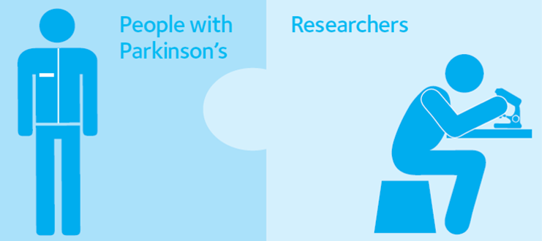
Research Involvement
Involvement is when researchers and the Parkinson’s community work in partnership to shape research.
Over 150 volunteers in the Patient and Public Involvement (PPI) contributor role
We’ve supported involvement in over 300 research projects through the PPI Programme
Training and support
Connect
Advise on planning and evaluation of involvement activities
Sharing best practice and stories of involvement
Notes:
Introduce self and team
It’s important that research is shaped by people with Parkinson's and their family and friends every step of the way. It’s about bringing those pieces of the puzzle with different perspectives and expertise together so that research is the best it can be. We’re here to support researchers and the Parkinson’s community to work together.
What we do:
Training and support - for researchers on involvement and considerations when working with the Parkinson’s community and for members of the Parkinson’s community to introduce them to the research process and what involvement can look like
Connecting researchers and members of the Parkinson’s community by sharing involvement opportunities - normally via email to our networks
Advice in planning and evaluating involvement activities - helping researchers plan where and how they might involve people
Promote and share best practice and stories of involvement- the practice of involvement in research is getting better but still a lot of work to do we work with organisations both national and international to amplify and drive forward the message around involvement.
We share involvement opportunities through a variety of routes but our first port of call is often the network of volunteers who have signed up to the PPI contributor role. An amazing group of volunteers who are particularly interested in shaping research and who have been through some training to support them to do so. But we will also share opportunities with the wider RSN, RIGs and local groups too.
Through our PPI programme we’ve supported involvement in over 400 projects- from pre-clincal to clinical research.
How the programme looks, how we work and the priorities we focus on to develop the programme is shaped by the people it’s for. We work closely with the Involvement steering group, made up of pwp, care partners and family members and researchers to make sure it’s meeting the needs of the different stakeholders.

Slide 5
Parkinson's research needs everyone. People with and without
Parkinson's, of every age, gender and ethnicity. Without people taking part, progress in Parkinson’s research would be impossible.
Taking part in research can range from completing surveys to taking part in a drug trial or testing a new device
We work with researchers to share opportunities for people to take part in research
In 2023 we helped 70 studies find participants
Notes:
Research Support Network of over 9000 people these will be volunteers and those staying up to date and taking part and getting involved in research. They all receive our regular emails to help them stay connected and help accelerate research.

Slide 6
Working with industry to improve clinical trials and potential treatments
Parkinson’s UK jointly hosted a workshop with pharmaceutical company UCB to get feedback from the Parkinson’s community on the form of medication to be used in a planned clinical trial, and how it should be packaged.
“
The thing I found most interesting was seeing a “light bulb” moment when one of the UCB members realised that taking medication in the middle of the day is problematic for some people particularly when they’re in work and have to fit medication round work and food.
This highlighted how important it is for researchers to work with people affected by Parkinson’s as they often do not understand the practicalities.
Neil, PPI Contributor, Scotland
Notes:
Its not just the medication that needs to be person centred. So does the trial itself - and we work with our community on that too.
We’ve supported global pharmaceutical company UCB with involvement on a number of different projects. In 2019, Parkinson’s UK and UCB hosted a workshop with 14 people with lived experience of Parkinson’s to discuss the form of a medication to be used in a planned new trial, and how it should be packaged.
Neil Morrison, a PPI contributor who is based in Scotland, and another PPI contributor Gillian shared their experience of taking part in the workshop. https://medium.com/parkinsons-uk/our-experience-of-working-with-a-company-to-improve-research-b5d8b1171fbf
What did we learn?
It quickly became apparent that sticking to medication schedules requires people to make significant adjustments to their daily lives.
When it came to the form of the new drug, people voted overwhelmingly in favour of a tablet or capsule over a liquid.
People much preferred medication to be packaged in blister packs over bottles, but again there were a number of ways they felt blister packs could be improved — for example, having blisters in multiples of seven would help people keep track of doses taken more easily.
A common theme that emerged during the day was the environmental impact of medications. Biodegradable packaging would help people feel more at ease.
The workshop provided invaluable insights for the UCB team, which will help the company design better medications that are easier for people with Parkinson’s to take.

Slide 7
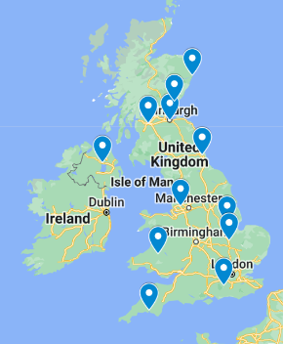
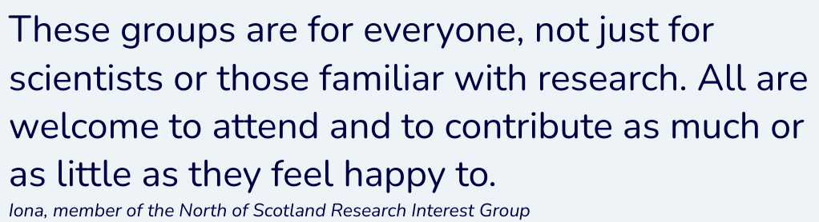
Research Interest Groups
We support 13 volunteer-led Research Interest Groups (RIGs) around the UK - in all 4 nations of the UK
These groups:
Unite those interested in research
Build relationships with researchers
Help keep their local communities informed through organising talks and events, lab visits, newsletters, social media, and even a research podcast
Notes:
Conference last week with 120 people from our community who choose to engage with us through a research lens…

Slide 8
Making research accessible
This is why we work with steering groups of people with Parkinson’s and their loved ones to help shape research and overcome some of the barriers to taking part in research
One area identified is allowing everyone to access opportunities to take part in research eg. linking up researchers with people living with the condition when they design a study, to make sure accessibility has been considered. Online options, home visits, phone calls a lot has changed since Covid times and research studies are a lot more inclusive. Eg. Cue-band and a study called CHIEF-PD that posted out medication patches and tried to overcome some of the geographical barriers https://chiefpd.blogs.bristol.ac.uk/sites/
We recently committed funding to a new study in Scotland using portable augmented reality glasses to help improve mobility of people with Parkinson’s. The proportion of our funding supporting more accessible and non-drug approaches has increased.
Using our influence to lobby for more clinical research sites across the UK eg. in Northern Ireland and agreeing joint funding for new neurology specialist research nurses in to enable clinical trials to be better supported there

Slide 9
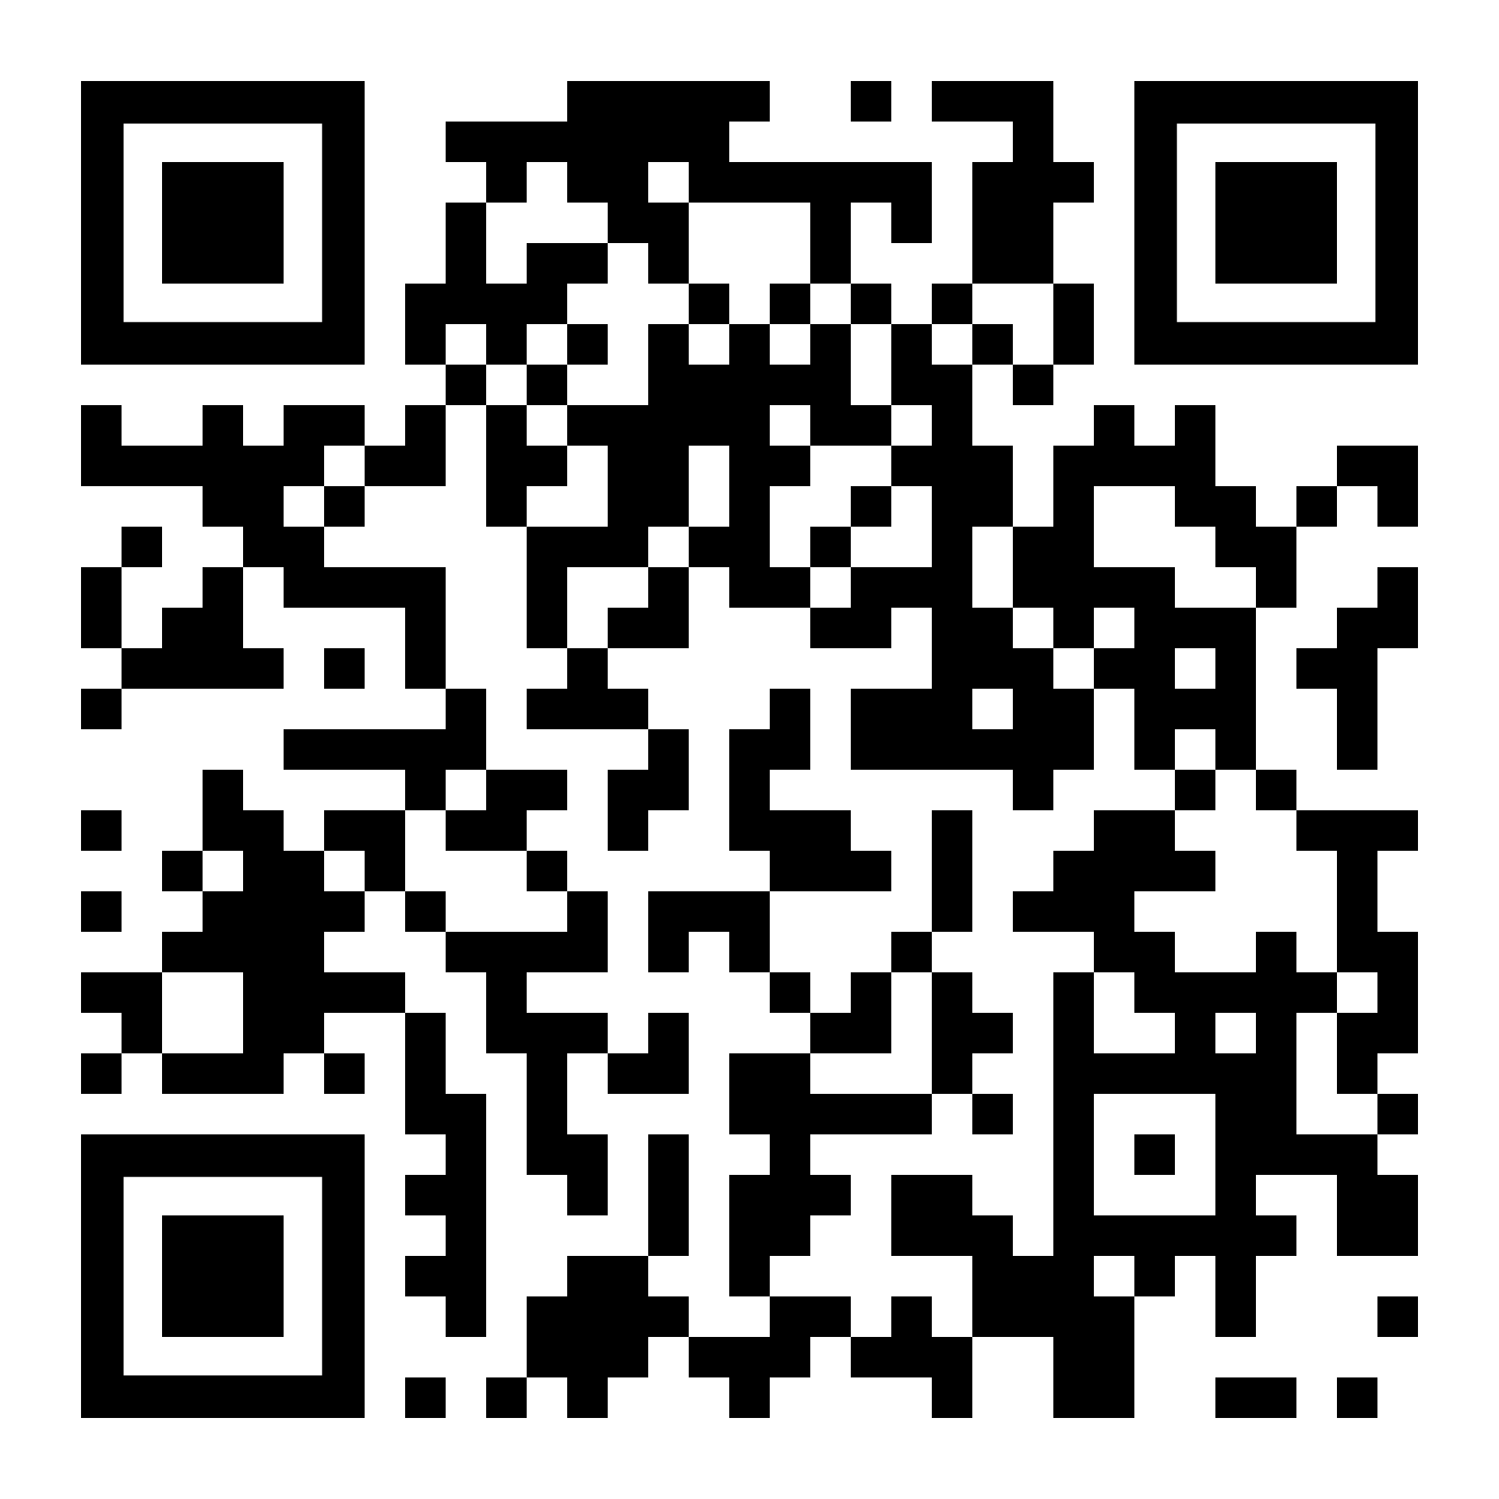
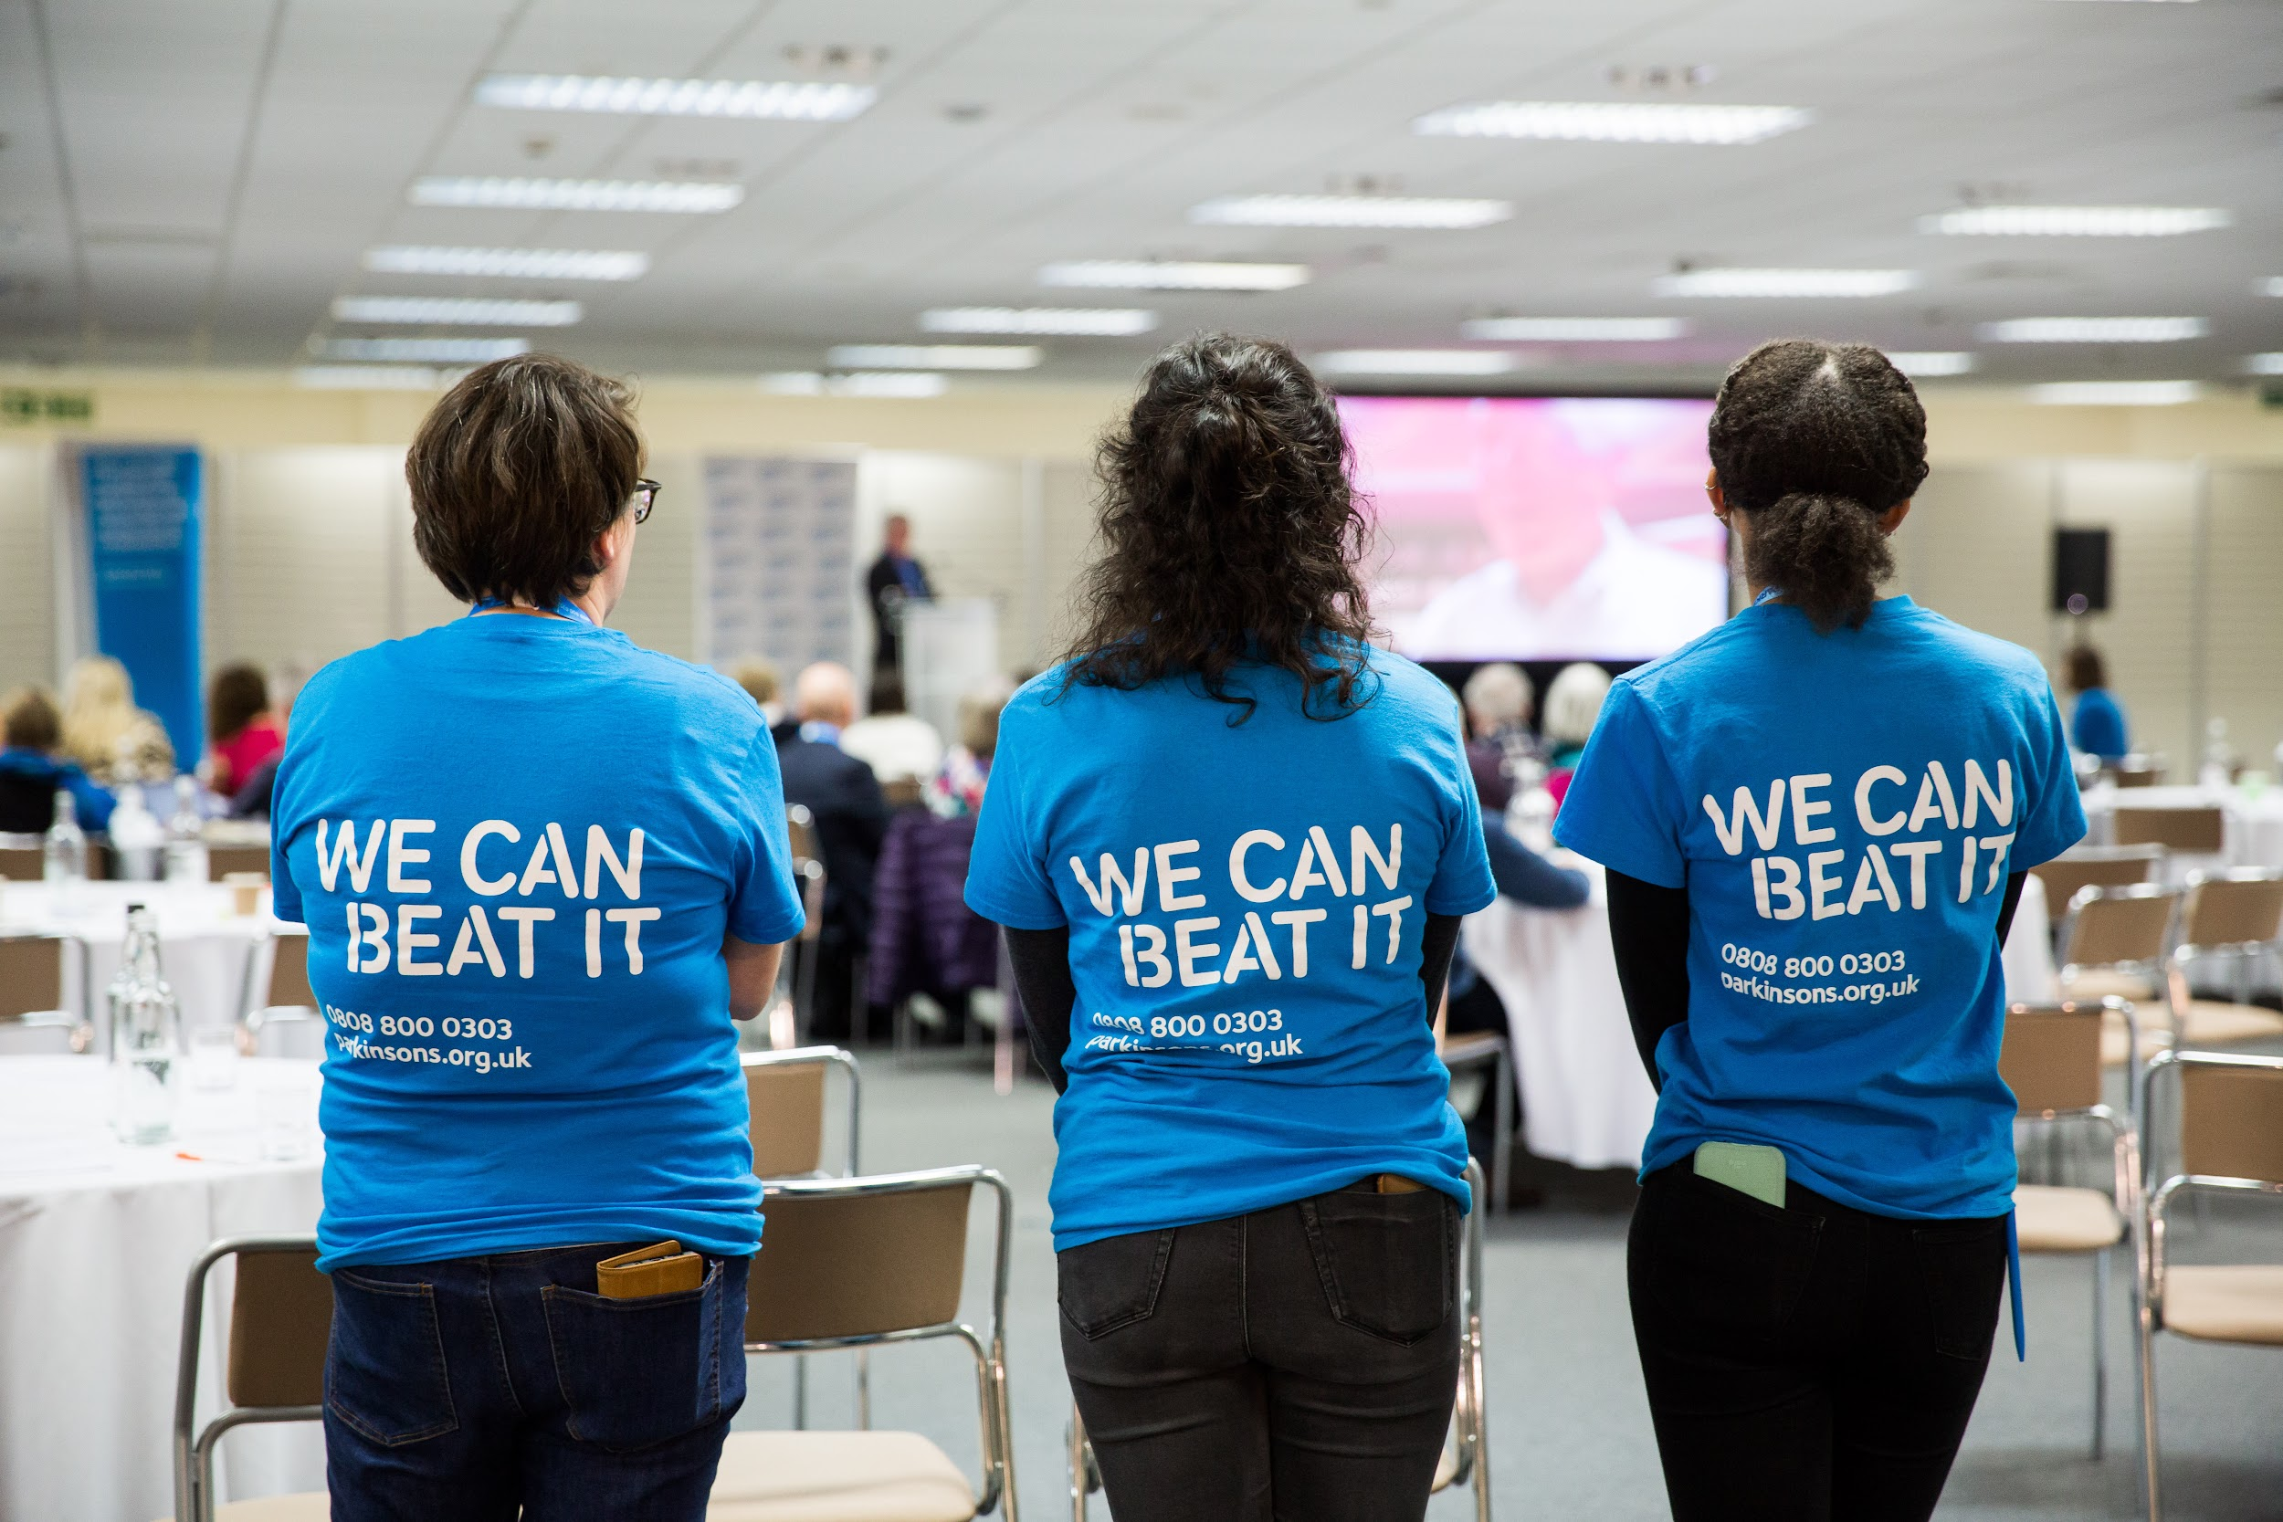
Stay up to date
Join Now!
Join the Research Support Network to receive regular emails with the latest research blogs, events and opportunities.
(Join over 9000 people helping to speed up Parkinson’s research)
Notes:
Join yourself and encourage others to join putting people at the heart of our research…

Slide 10
Info on priority setting work
https://www.parkinsons.org.uk/research/improving-life-through-research link has some lists of symptoms that people identified as the symptoms that matters most to them and fed into our priorities
Notes:
In 2014, we worked with the James Lind Alliance and researchers at UK universities to ask people with Parkinson's about their priorities for Parkinson's research. The top three priorities identified were balance and falls, stress and anxiety and uncontrollable movements.

Slide 11
Thank you
James Jopling Scotland Director, Parkinson’s UK

